Slide 1
Capstone Project University success analysis
By manav Mishra

Slide 2
TOPICS
Project Overview
Information about Dataset tables
ER Diagram
MECE-Breakdown
Solving Power Bi and EDA Questions
Dashboard Analysis
Conclusion

Slide 3
Project Overview
The objective of this project is to develop a comprehensive Power BI dashboard using data from various university ranking systems to provide valuable insights into the global higher education landscape. The analysis will cover university demographics, ranking criteria, trends over time, and performance metrics, facilitating data-driven decision-making and enhancing the understanding of university rankings. The dashboard will offer insights into University Demographics & Distribution, University Ranking System Analysis, University Metrics and Performance, and Trends and Patterns, allowing users to explore correlations between ranking criteria, demographic factors, and university performance. Additionally, an essential phase of Exploratory Data Analysis (EDA) using SQL queries will extract and analyze the dataset to uncover factors influencing university rankings, changes over time, and correlations between variables. The results of the EDA will be presented through visualizations in an Excel file, including charts, graphs, and tables, providing stakeholders with a comprehensive overview of the project's insights alongside the Power BI dashboard. Overall, the project aims to empower stakeholders in the education sector with actionable insights to enhance university performance, attract international students, and drive continuous improvement in the global higher education landscape.

Slide 4
Information About Dataset Table
country: This is a simple list of countries that were in the data set. I don’t think it’s a complete list of all countries, but it’s enough for this data set.
University: A list of universities that were ranked in this system. Each university is related to a country.
ranking_system: This contains the three different ranking systems used: Times Higher Education World University Ranking, Shanghai Ranking, and Center for World University Rankings.
ranking_criteria: This table contains the different criteria used in each ranking system, such as Citations and Quality of Education. It also contains criteria for Total Score for each system.
university_year: The university_year table contains values for measurements such as the number of students and the student to staff ratio for each university in several years.
university_ranking_year: This table contains the score for each year for each university and ranking criteria. It’s the largest table in the database.
Notes:
country
This is a simple list of countries that were in the data set. I don’t think it’s a complete list of all countries, but it’s enough for this data set.
university
A list of universities that were ranked in this system. Each university is related to a country.
ranking_system
This contains the three different ranking systems used: Times Higher Education World University Ranking, Shanghai Ranking, and Center for World University Rankings.
ranking_criteria
This table contains the different criteria used in each ranking system, such as Citations and Quality of Education. It also contains criteria for Total Score for each system.
university_year
The university_year table contains values for measurements such as the number of students and the student to staff ratio for each university in several years.
university_ranking_year
This table contains the score for each year for each university and ranking criteria. It’s the largest table in the database.

Slide 5
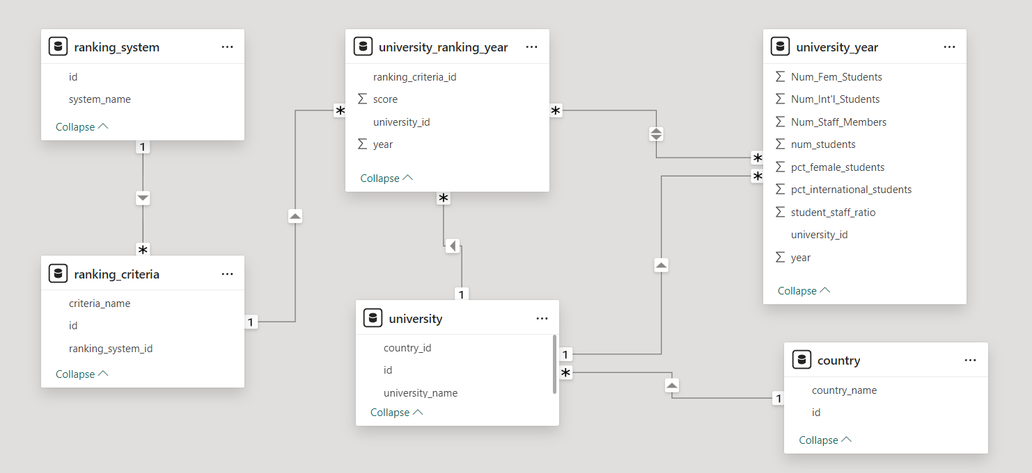
ER diagram

Slide 6
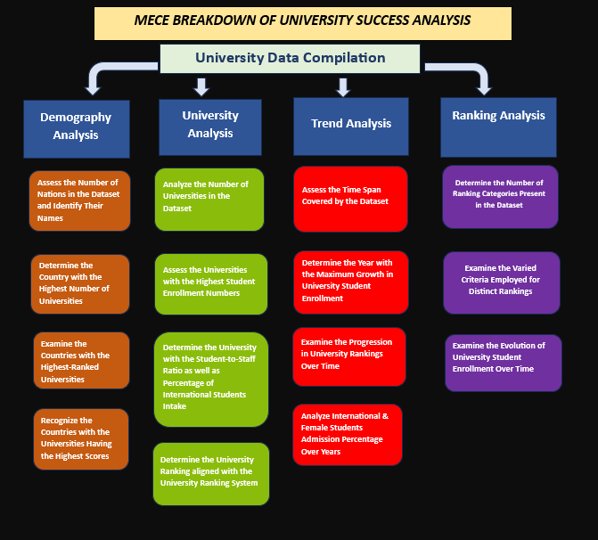
MECE-Breakdown

Slide 7
MECE-Breakdown
Demography Analysis
University Analysis
Number of universities in each country.
Distribution of International & Female students across different countries.
Country with the highest number of female students enrolled in universities.
Distribution of universities across different countries.
University Ranking by country.
Number of universities ranked by each ranking system.
Score for universities according to each ranking system.
Trend in university rankings over the years according to each system.
Impact of the ranking system on a university international student enrolment.
Correlation between university's ranking and its student-staff ratio.
Correlation between university ranking score & percent of female students.
Correlation between university ranking score & student-staff ratio over the years.

Slide 8
MECE-Breakdown
Ranking Analysis
Trends Analysis
Most important criteria considered by ranking systems.
University Distribution by Ranking System.
University Score & Student Staff Ratio by ranking System.
Distribution of International & Female students by Ranking System.
Impact of Female Student percentage on Ranking.
Trends in the number of universities over the years.
Trends in University Student Staff Ratio over the years.
Trend in Male, Female & Total Students over years.
Trends in the ranking score of universities over the years.
Relationship between university ranking score & student staff ratio over time.

Slide 9
POWER BI Questions
How many universities are there in each country?
What is the distribution of international students across different countries?
Which country has the highest number of female students enrolled in universities?
How many universities are ranked by each ranking system?
What is the average score for universities according to each ranking system?
How does the ranking system affect a university's student-staff ratio?
What are the most important criteria considered by ranking systems?
Is there a correlation between a university's score and the number of international students?
How does the percentage of female students impact a university's ranking?
Which university has the highest number of students?
How does the percentage of international students vary across different universities?
Is there a correlation between a university's ranking and its student-staff ratio?
How does the number of students in universities change over time?
Is there a correlation between a university's ranking score and the student-staff ratio over the years?
How does the percentage of international students vary across different years?
What is the impact of a university's ranking on the number of international students it attracts?
Is there a relationship between a university's ranking score and the percentage of female students enrolled?
How does the percentage of international students affect a university's student-staff ratio?
Are there any significant trends or patterns in the rankings of universities from different countries?

Slide 10
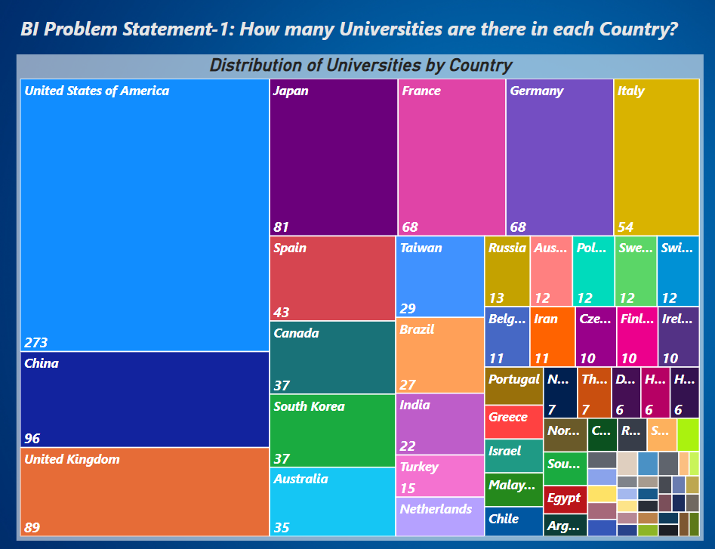
How many universities are there in each country?
The visualization illustrates a global distribution of universities with a strong concentration in the United States, followed by significant representations from China, the United Kingdom, and other countries. It highlights the diversity and geographical spread of higher education institutions, emphasizing the contributions of various countries to the global academic environment. The data can be used to understand regional strengths in higher education and to identify potential areas for collaboration and investment in the global educational landscape.

Slide 11
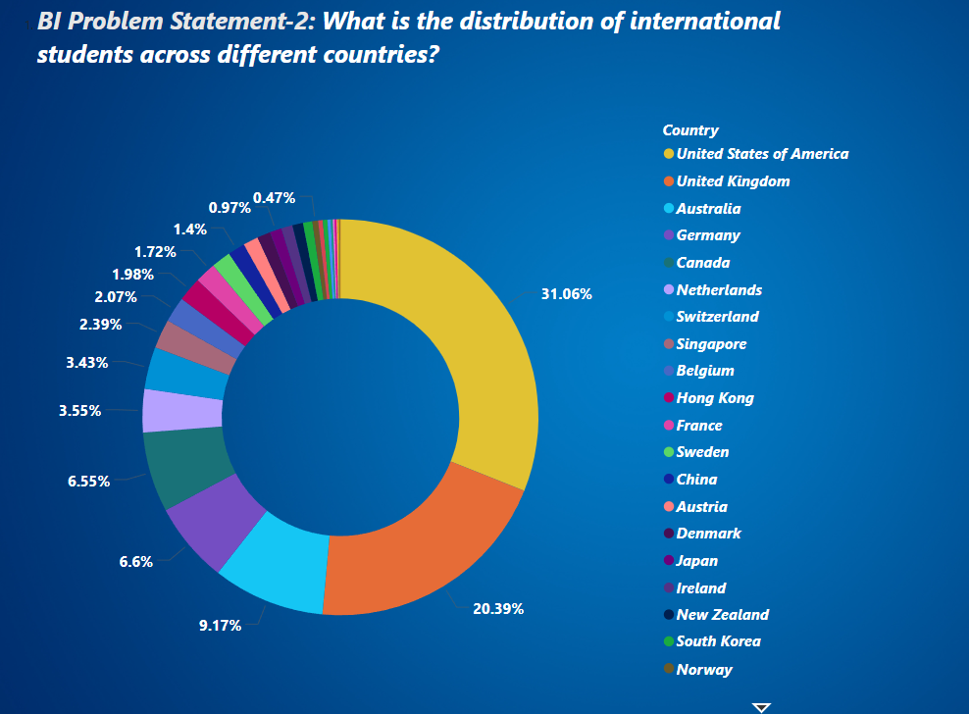
What is the distribution of international students across different countries?
The donut chart reveals that a substantial proportion of universities are located in the United States and the United Kingdom, with these two countries alone making up over half of the total universities. Australia, Germany, and Canada also have notable shares, indicating their strong positions in global higher education. The rest of the countries have smaller, yet diverse, representations, showcasing the widespread geographical distribution of universities but also highlighting the concentration in a few key nations. This distribution can be useful for understanding global educational trends and for targeting policies or initiatives aimed at improving or collaborating with higher education institutions.

Slide 12
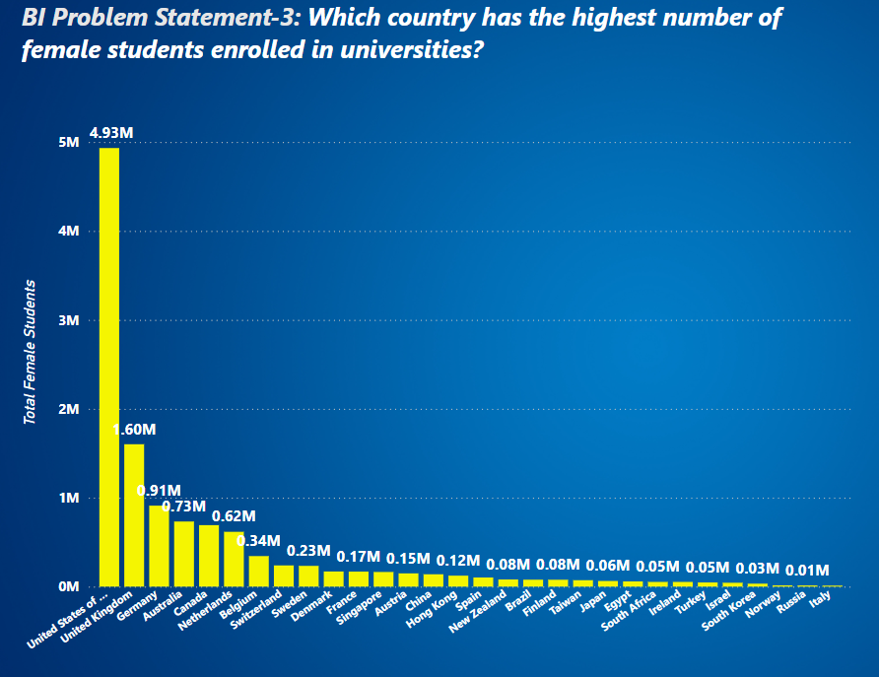
Which country has the highest number of female students enrolled in universities?
The bar chart reveals a stark contrast in the number of female students across different countries, with the United States leading by a significant margin. The United Kingdom, Australia, and Germany also have substantial numbers, reflecting their strong emphasis on female education. Other countries show a more moderate to lower representation, which might indicate varying levels of female enrolment and access to higher education. This distribution can help identify regions where female educational participation is high and others where it may need further encouragement and support.

Slide 13
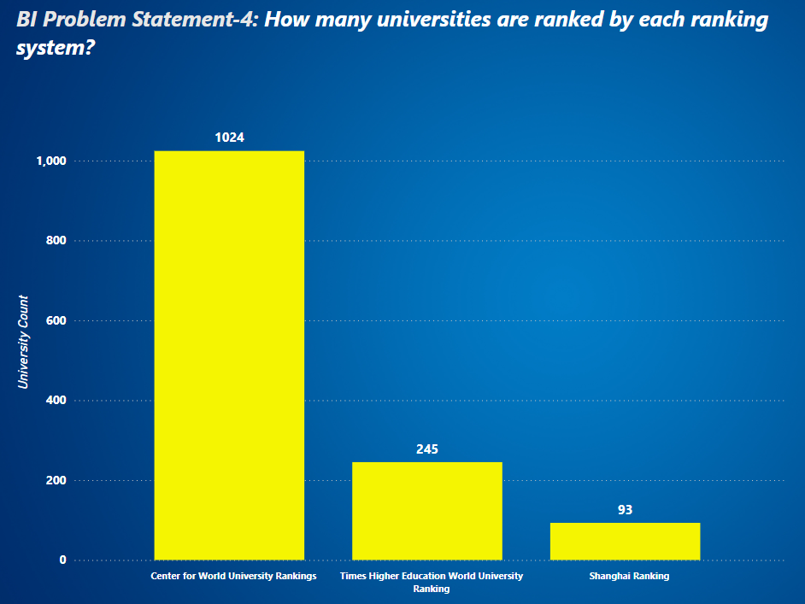
How many universities are ranked by each ranking system?
The bar chart reveals a significant disparity in the number of universities included across three global university ranking systems: the Centre for World University Rankings (CWUR), Times Higher Education World University Ranking (THE), and the Shanghai Ranking (Academic Ranking of World Universities, ARWU). The CWUR features an extensive list, encompassing 1024 universities, which is considerably higher compared to the 245 universities included by THE and the 93 universities listed by the Shanghai Ranking. This substantial difference suggests that CWUR might employ less stringent criteria or a broader approach in ranking institutions globally.

Slide 14
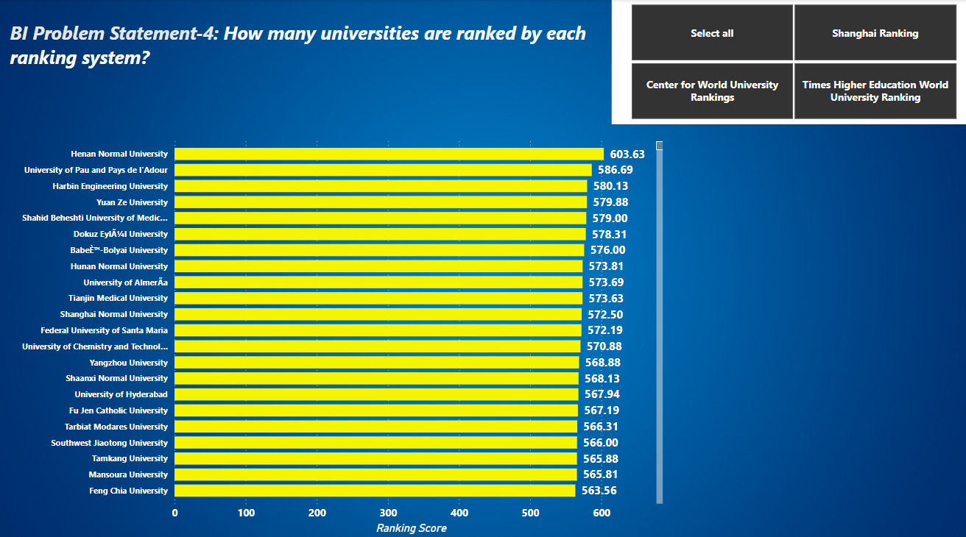
What is the average score for universities according to each ranking system?
The bar chart displays the ranking scores of various universities, highlighting their relative positions based on the assigned scores. Henan Normal University leads with a score of 603.63, significantly higher than the other institutions listed. The University of Pau and Pays de l'Adour follows with 586.69, while Harbin Engineering University and Yuan Ze University also score above 579. The chart reveals a gradual decrease in scores as one moves down the list, with Feng Chia University at the bottom with a score of 563.56. The scores of the universities are closely clustered, indicating a narrow range of differences among them. This suggests that while Henan Normal University holds a notable lead, the other universities are relatively close in terms of ranking scores. The universities listed include a mix of institutions from different countries, reflecting a diverse representation in the ranking. This diversity underscores the global nature of the ranking system, which evaluates and scores universities from various regions, including China, Taiwan, Iran, Romania, and France, among others

Slide 15
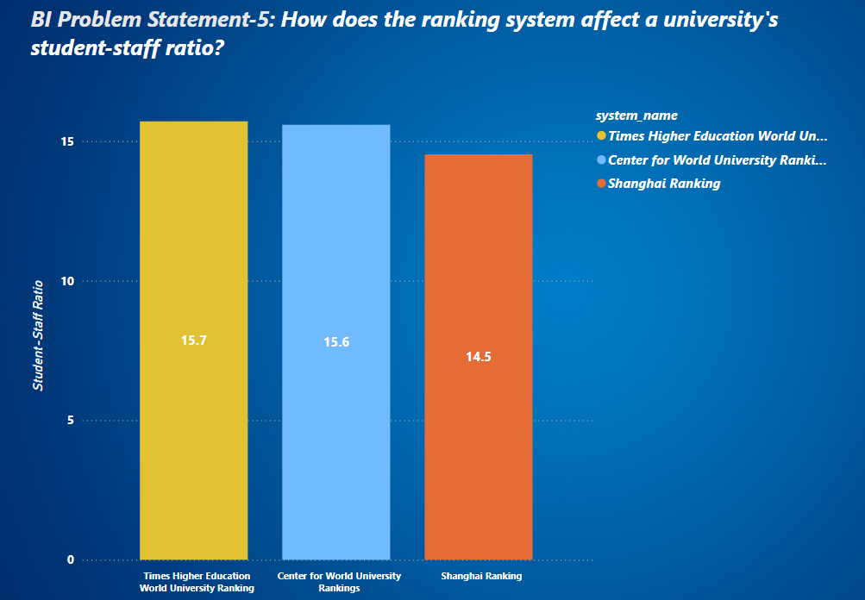
How does the ranking system affect a university's student-staff ratio?
The bar chart presents a comparison of the student-staff ratios across three major university ranking systems: Times Higher Education World University Ranking (THE), Centre for World University Rankings (CWUR), and Shanghai Ranking (ARWU). The data indicates that the Shanghai Ranking reports the lowest student-staff ratio at 14.5, suggesting a smaller number of students per staff member, which can be indicative of more personalized attention and potentially better educational outcomes. In contrast, the Times Higher Education World University Ranking shows the highest student-staff ratio at 15.7, closely followed by the Centre for World University Rankings with a ratio of 15.6. The slight difference between THE and CWUR suggests that their listed universities have a relatively similar student-staff dynamic, which is marginally higher than that of the Shanghai Ranking.

Slide 16
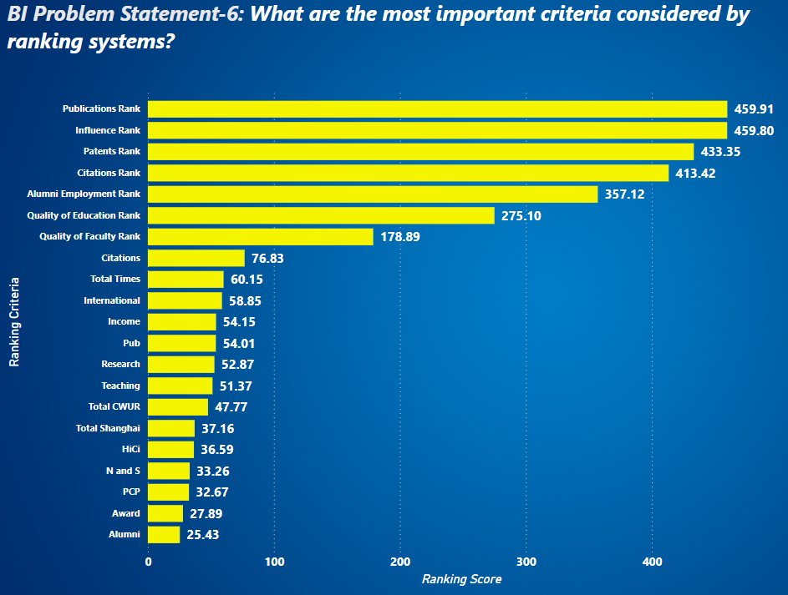
What are the most important criteria considered by ranking systems?
One key takeaway is the ability to identify potential specializations. Universities likely excel in certain areas. If you know what you want to study, look for institutions consistently ranking high in that specific criteria. Conversely, universities ranking well across most criteria might be ideal for those seeking a well-rounded education. The chart can also reveal trade-offs. A top research university might have a lower student satisfaction ranking due to a demanding environment. This helps you prioritize what's most important in your university experience.

Slide 17
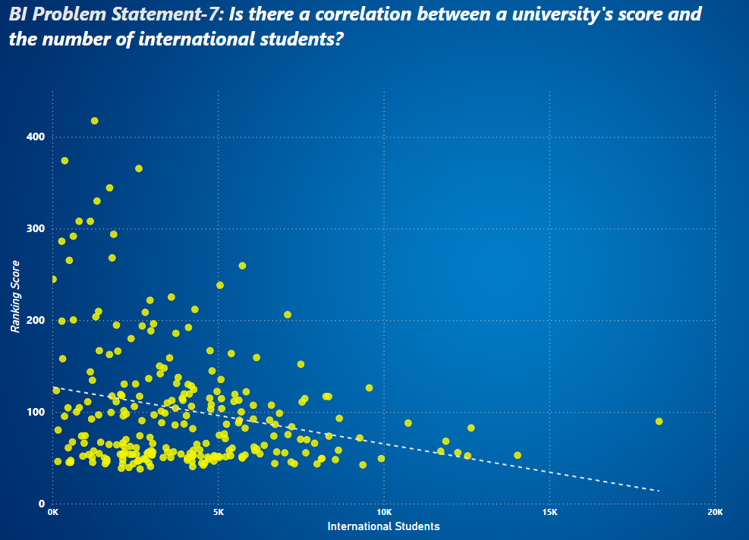
Is there a correlation between a university's score and the number of international students?
The scatter plot reveals an intriguing relationship between the number of international students and ranking scores for educational institutions, likely universities. A clear negative correlation emerges, suggesting that as institutions enrol more international students, their ranking scores tend to decrease. However, this relationship is not uniform across the dataset. The majority of institutions cluster in the lower left quadrant, indicating that many have fewer than 5,000 international students and ranking scores below 200. Interestingly, the plot also showcases several outliers – institutions with exceptionally high-ranking scores despite having relatively few international students. These outliers hint at the complexity of factors influencing rankings beyond just international student enrolment. As we move right on the chart, we observe that the spread of ranking scores narrows, implying that institutions with larger international student populations tend to have more consistent, albeit generally lower, ranking scores. Overall, this visualization underscores that while there's a general trend linking higher international student numbers to lower ranking scores, the relationship is nuanced and likely influenced by numerous other factors not captured in this two-dimensional representation.

Slide 18
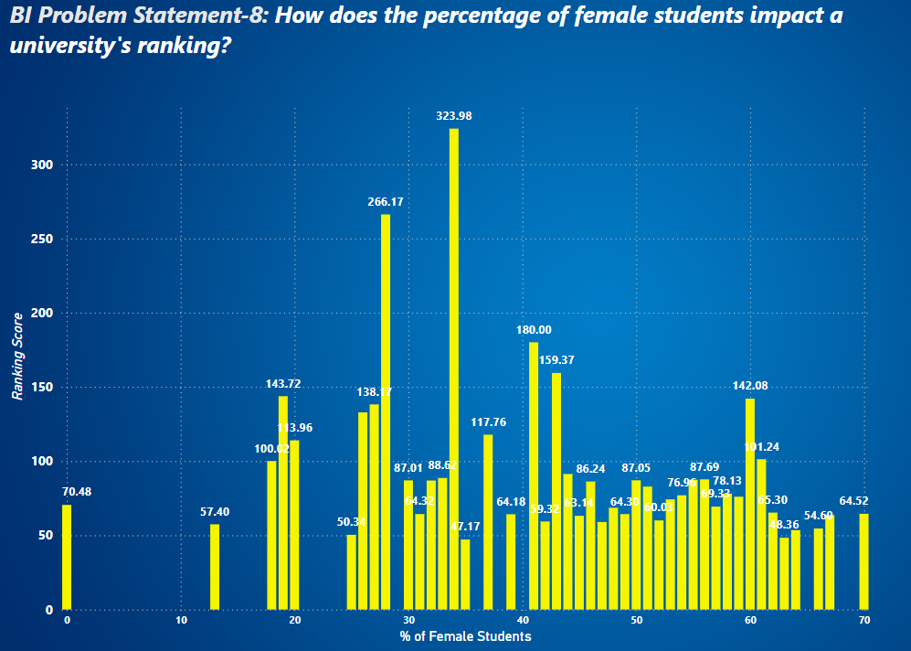
How does the percentage of female students impact a university's ranking?
This bar chart illustrates the relationship between the percentage of female students and ranking scores across various institutions, likely educational establishments. The data presents a complex and non-linear relationship between gender diversity and institutional rankings. Notably, there are significant spikes in ranking scores at certain percentages of female enrolment, particularly around the 30-40% range, where we see the highest-ranking score of 323.98 at approximately 35% female students. Another prominent peak occurs at about 28% female students, with a ranking score of 266.17. Interestingly, the chart reveals that institutions with gender parity or a higher percentage of female students (50% and above) generally have lower ranking scores, mostly falling below 100. This trend suggests that having a more balanced or femaledominated student body does not necessarily correlate with higher institutional rankings. The data also shows considerable variability in ranking scores across different percentages of female enrolment, indicating that other factors likely play significant roles in determining an institution's ranking beyond gender composition alone.

Slide 19
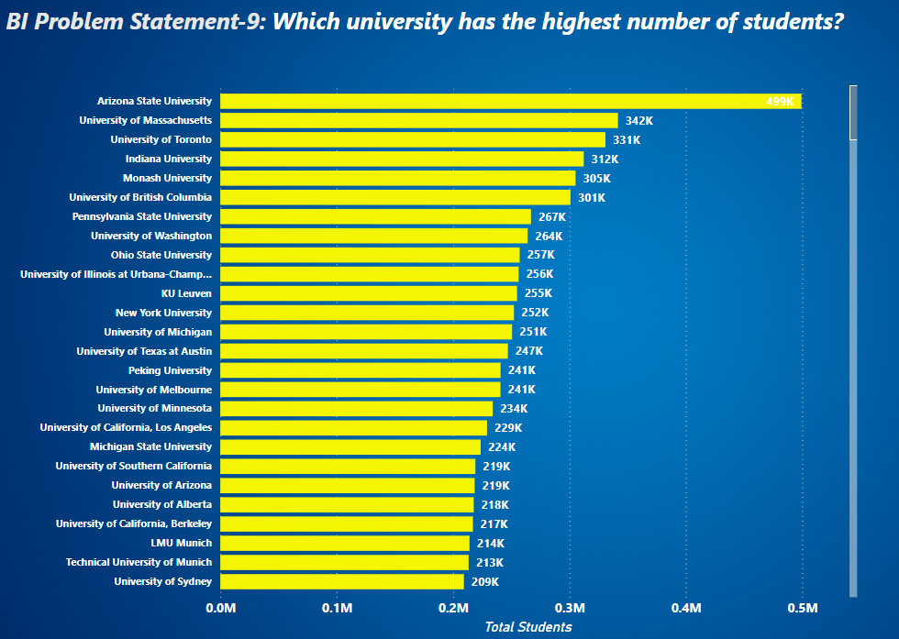
Which university has the highest number of students?
This bar chart presents a comparison of total student populations across various prominent universities worldwide. Arizona State University stands out as the clear leader, boasting an impressive 347,000 students, significantly outpacing its peers. Following closely are the University of Massachusetts and the University of Toronto, with 342,000 and 331,000 students respectively, forming a top tier of mega-universities. The data reveals a notable presence of North American institutions, particularly from the United States, dominating the upper ranks of student population. However, the list also includes several international universities, such as Monash University and the University of British Columbia, highlighting the global nature of large-scale higher education. Interestingly, the chart shows a gradual decrease in student numbers as we move down the list, with most universities falling within the 200,000 to 300,000 student range. This pattern suggests a certain threshold or optimal size for large universities, possibly balancing factors such as resources, infrastructure, and educational quality.

Slide 20
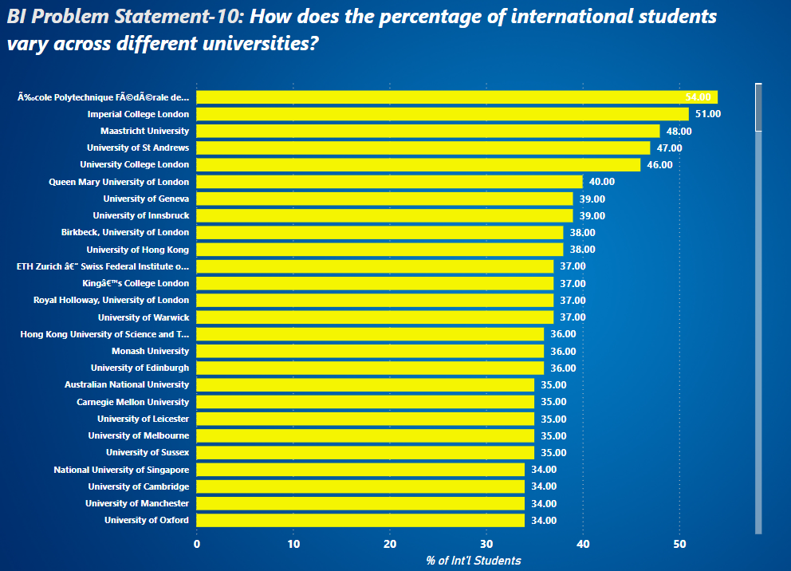
How does the percentage of international students vary across different universities?
This bar chart illustrates the percentage of international students across various prestigious universities worldwide, offering intriguing insights into global higher education trends. École Polytechnique Fédérale de Lausanne leads the pack with an impressive 55% international student population, closely followed by Imperial College London at 51%. This high proportion of international students at top institutions underscores the increasingly global nature of elite education. The data reveals a strong representation of UK universities, with institutions like the University of St Andrews, University College London, and several University of London colleges featuring prominently in the top ranks. This suggests that UK higher education continues to be highly attractive to international students, possibly due to factors such as English-language instruction, academic reputation, and cultural appeal. Interestingly, the chart also includes universities from continental Europe, Asia, and Australia, indicating that the appeal of international education extends beyond traditional Anglophone countries. Universities like Maastricht University, ETH Zurich, and the National University of Singapore showcase the diverse geographical spread of institutions attracting significant international student populations.

Slide 21
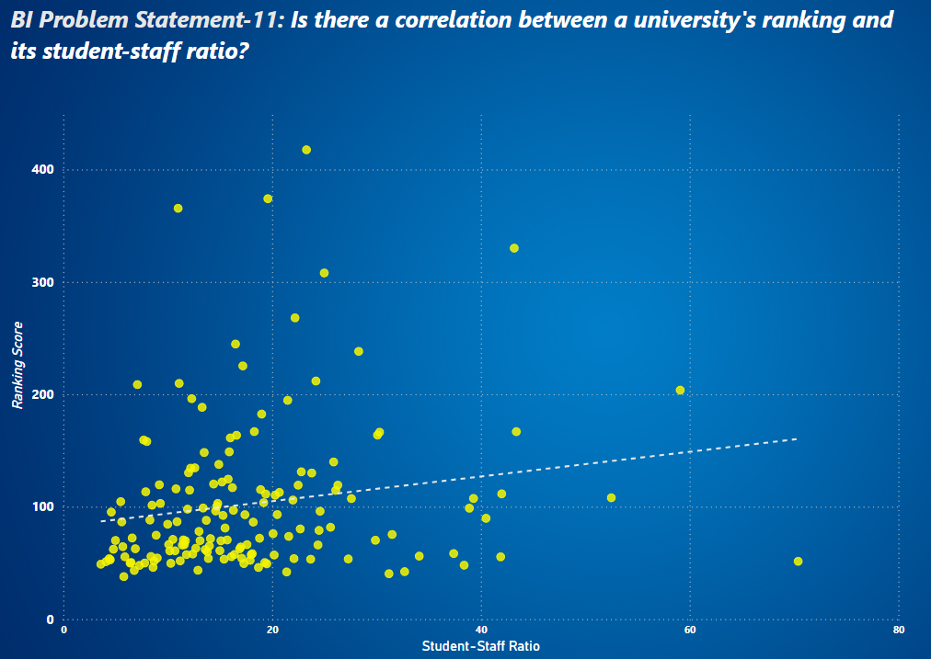
Is there a correlation between a university's ranking and its student-staff ratio?
This scatter plot illustrates the relationship between student-staff ratios and ranking scores for what appear to be educational institutions, likely universities. The x-axis represents the student-staff ratio, while the y-axis shows the ranking score. The plot reveals several interesting patterns and insights about the interplay between these two factors in educational settings. The data points are widely dispersed, indicating a complex relationship between student-staff ratios and ranking scores. There's a slight positive correlation, as shown by the gently upward-sloping trend line, suggesting that higher student-staff ratios are associated with marginally higher-ranking scores. However, this relationship is weak, and the wide scatter of points indicates that many other factors likely influence an institution's ranking. Most institutions cluster in the lower left quadrant of the graph, with student-staff ratios between 0 and 20, and ranking scores below 200. This concentration suggests that many institutions maintain relatively low student-staff ratios, possibly to ensure more personalized attention and higher quality of education.

Slide 22
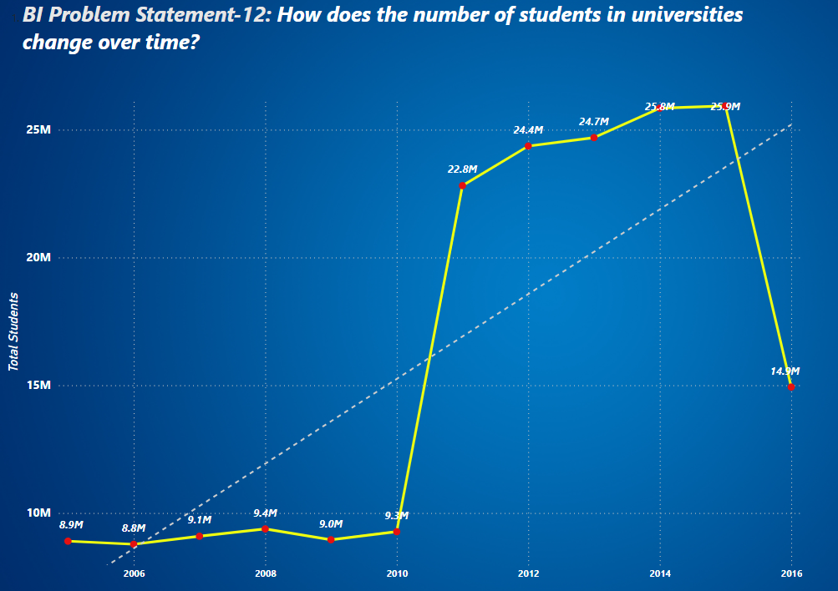
How does the number of students in universities change over time?
This graph shows the trend of total students over time, likely in an educational system or institution. The data spans from 2006 to 2016, with measurements every two years. From 2006 to 2010, there was a gradual increase in student numbers, rising from 8.9 million to 9.3 million. However, the most striking feature of the graph is the dramatic spike that occurs between 2010 and 2012. During this period, the number of students more than doubled, jumping from 9.3 million to 22.8 million. After this sudden increase, the growth continued but at a more moderate pace. The student population reached 24.4 million in 2012, then 24.7 million in 2014, peaking at 25.9 million in 2015 or early 2016. Interestingly, the graph shows a sharp decline at the end, with numbers dropping to 14.9 million in 2016. This significant decrease might indicate a major policy change, a shift in data collection methods, or some other substantial event affecting student enrolment.

Slide 23
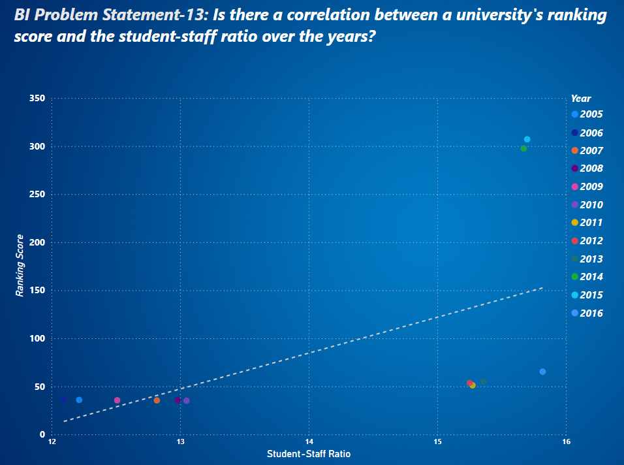
Is there a correlation between a university's ranking score and the student-staff ratio over the years?
This graph depicts the relationship between Student-Staff Ratio and Ranking Score across different years from 2005 to 2016. The x-axis represents the Student-Staff Ratio, ranging from 12 to 16, while the y-axis shows the Ranking Score, which goes up to 350. There's a clear positive correlation between the Student-Staff Ratio and Ranking Score. As the Student-Staff Ratio increases (moving right on the x-axis), the Ranking Score tends to increase as well (moving up on the axis). This suggests that institutions with higher student-to-staff ratios generally achieve higher ranking scores. The data points are color-coded by year, allowing us to see how this relationship has evolved over time. Most of the earlier years (2005-2012) cluster in the lower left of the graph, indicating lower student-staff ratios and lower ranking scores. In contrast, the more recent years (2013-2016) are positioned in the upper right, showing both higher ratios and higher scores.

Slide 24
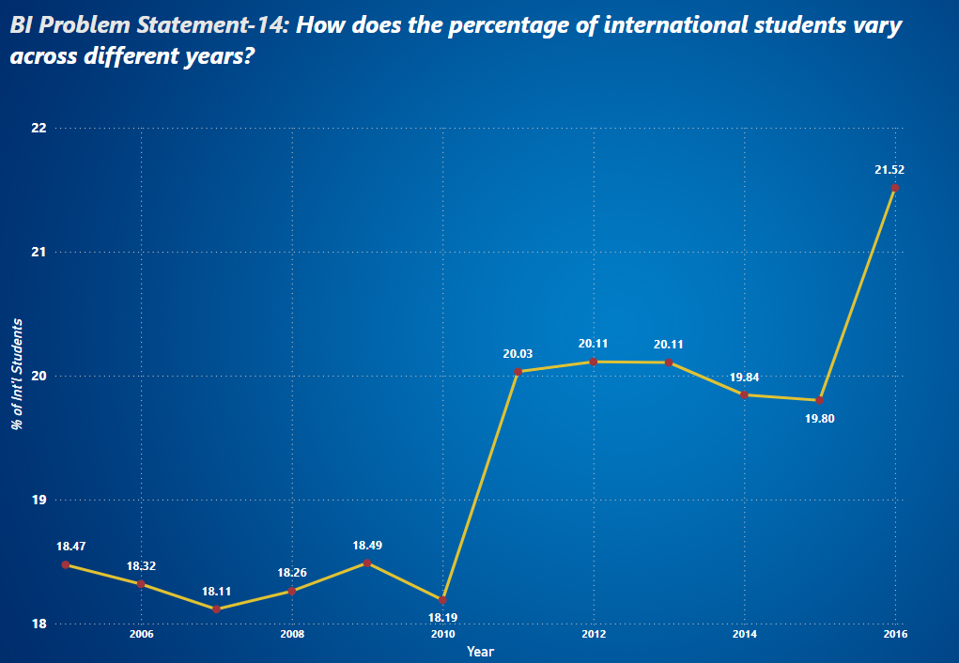
How does the percentage of international students vary across different years?
This graph illustrates the percentage of international students over a decade, from 2006 to 2016. The y-axis represents the percentage of international students, while the x-axis shows the years. The trend begins in 2006 with 18.47% international students. There's a slight fluctuation in the early years, with the percentage dropping to 18.11% in 2008, then rising slightly to 18.49% in 2010. A significant change occurs between 2010 and 2011. The percentage of international students jumps dramatically from 18.19% to 20.03%, an increase of nearly 2 percentage points. This sharp rise suggests a possible change in policy, increased recruitment efforts, or other factors that suddenly made the institution much more attractive or accessible to international students. After this sharp increase, the percentage of international students remains relatively stable for a few years, hovering around 20%. There's a slight increase to 20.11% in 2012, which holds steady through 2013.From 2013 to 2015, there's a small decline, with the percentage dropping to 19.84% in 2014 and further to 19.80% in 2015. This might indicate a slight shift in enrolment patterns or policies during this period. Overall, the graph shows a general upward trend in the percentage of international students over the decade, with two notable jumps: one between 2010 and 2011, and another between 2015 and 2016.

Slide 25
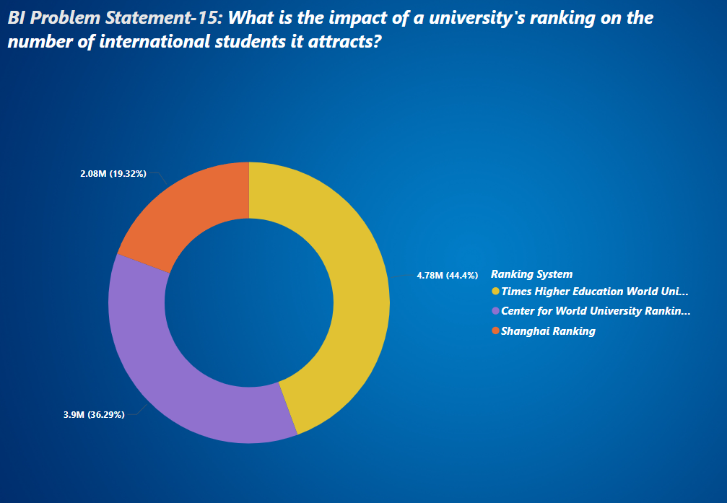
What is the impact of a university's ranking on the number of international students it attracts?
This pie chart illustrates the distribution of three major university ranking systems. The chart provides insights into the relative prominence or usage of these ranking systems in the higher education landscape. The largest segment, comprising 44.4% of the total, represents the Times Higher Education World University Rankings. This indicates that it is the most widely recognized or utilized ranking system among the three, accounting for nearly half of the representation. The second largest segment, coloured purple, represents the Centre for World University Rankings, which accounts for 36.29% of the total. This suggests that while not as dominant as the Times Higher Education rankings, it still holds a significant position in the university ranking sphere. The Shanghai Ranking, represented by the orange segment, makes up 19.32% of the total. While it has the smallest share among the three, it still represents a substantial portion, indicating its relevance in the global university ranking landscape. Overall, this visualization effectively demonstrates the relative importance or prevalence of these three ranking systems in the global higher education context, with the Times Higher Education World University Rankings holding the most prominent position, followed by the Centre for World University Rankings, and then the Shanghai Ranking.

Slide 26
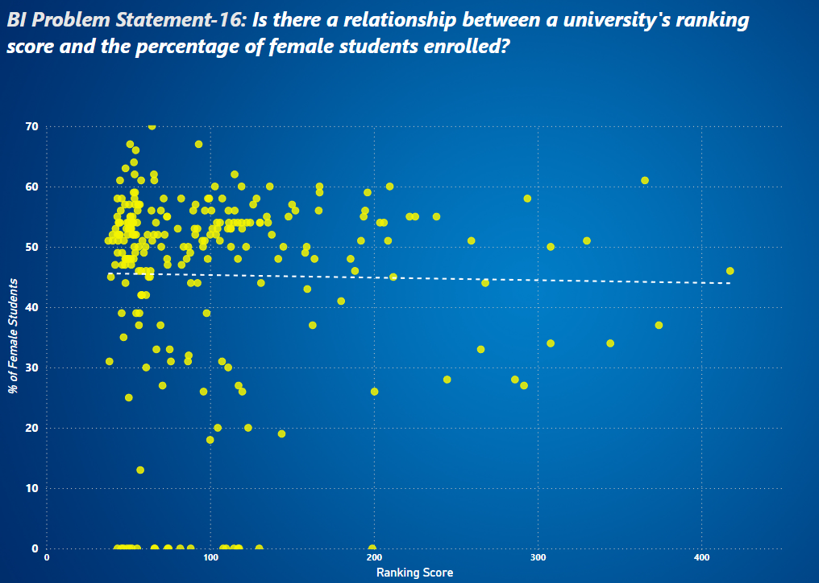
Is there a relationship between a university's ranking score and the percentage of female students enrolled?
The Ranking Score ranges from 0 to about 450, while the percentage of female students spans from 0% to 70%. A notable feature is a dotted horizontal line at around 46% female students, which may represent an average or target percentage. There's a high concentration of institutions in the 40-60% range for female students, particularly for those with lower ranking scores (0-200). As the Ranking Score increases, there's a slight decrease in the density of data points, suggesting fewer institutions with very high scores. There's a cluster of points at 0% female students across various ranking scores, which could represent all-male institutions or incomplete data. The highest-ranking institutions (scores above 300) show a wide spread in female student percentages, ranging from about 30% to 60%. There doesn't appear to be a strong correlation between Ranking Score and percentage of female students. High-ranking institutions have varying levels of female representation, as do lower ranking ones. The majority of institutions fall below the 60% female student mark, with only a few exceeding this percentage. This visualization suggests that while there's significant variation in female student representation across institutions, higher ranking scores don't necessarily correlate with higher or lower percentages of female students. The data also indicates that most institutions have a relatively balanced gender distribution, with a slight skew towards male students in many cases.

Slide 27
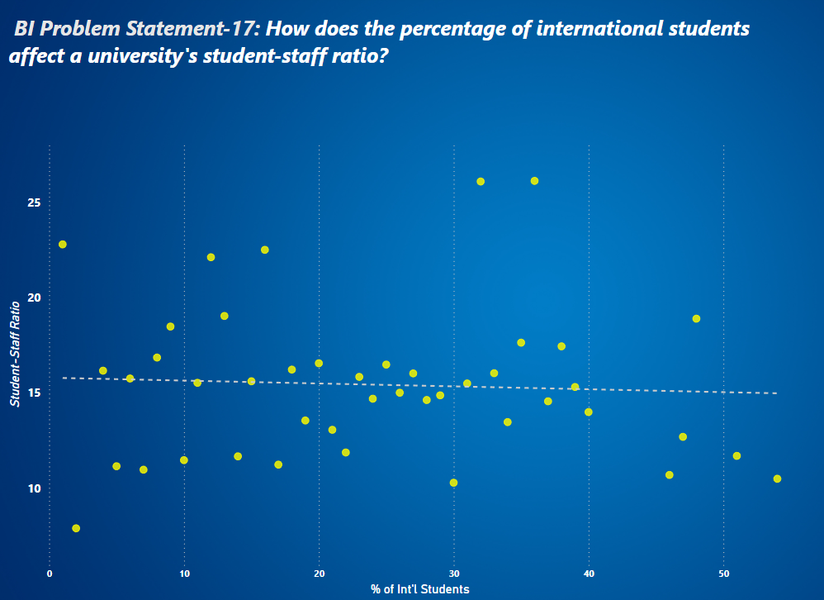
How does the percentage of international students affect a university's student-staff ratio?
This scatter plot displays the relationship between the percentage of international students (x-axis) and the student-staff ratio (y-axis) across various institutions, likely universities or colleges. The data points are scattered across the graph with a slight downward trend, as indicated by the dashed trend line. This suggests a weak negative correlation between the two variables. As the percentage of international students increases, there's a slight tendency for the student-staff ratio to decrease, though this relationship is not strong or consistent across all data points. There's considerable variation in both variables. The percentage of international students ranges from near 0% to about 50%, while the student-staff ratio varies from around 10 to 25. Some institutions have high percentages of international students with relatively low student-staff ratios, while others show the opposite pattern. Overall, while there's a slight trend suggesting that institutions with more international students might have lower student-staff ratios, the relationship is not strong enough to draw definitive conclusions without considering other potential influencing factors.

Slide 28
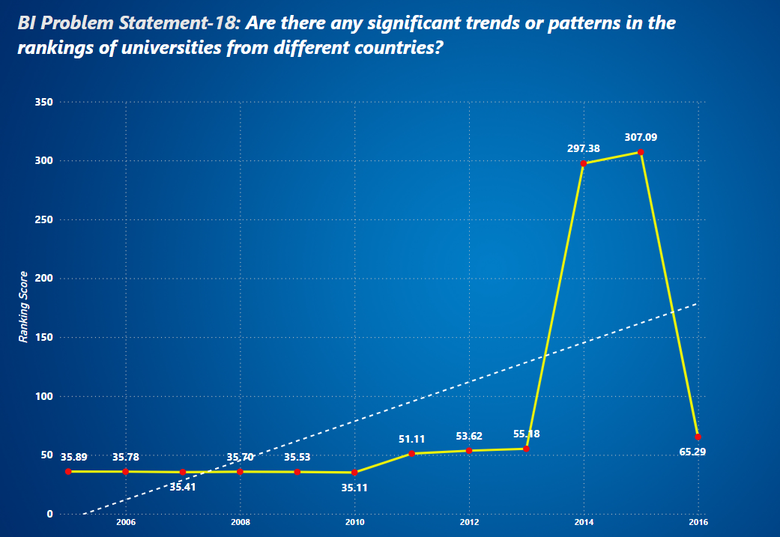
Are there any significant trends or patterns in the rankings of universities from different countries?
The visual shows the university's ranking score from 2005 to 2016, highlighting several key trends. Initially, the ranking score remained stable around the mid-30s until 2010. From 2011 to 2014, the score steadily improved, reaching 55.18. A significant spike occurred in 2015, with the score peaking at 297.38, likely due to substantial achievements or changes. However, in 2016, the score declined sharply to 65.29, although it remained higher than pre-2011 levels. Overall, despite fluctuations, the long-term trend indicates an upward trajectory, reflecting consistent improvement in the university's performance over the period.

Slide 29

University Success Analysis

Slide 30
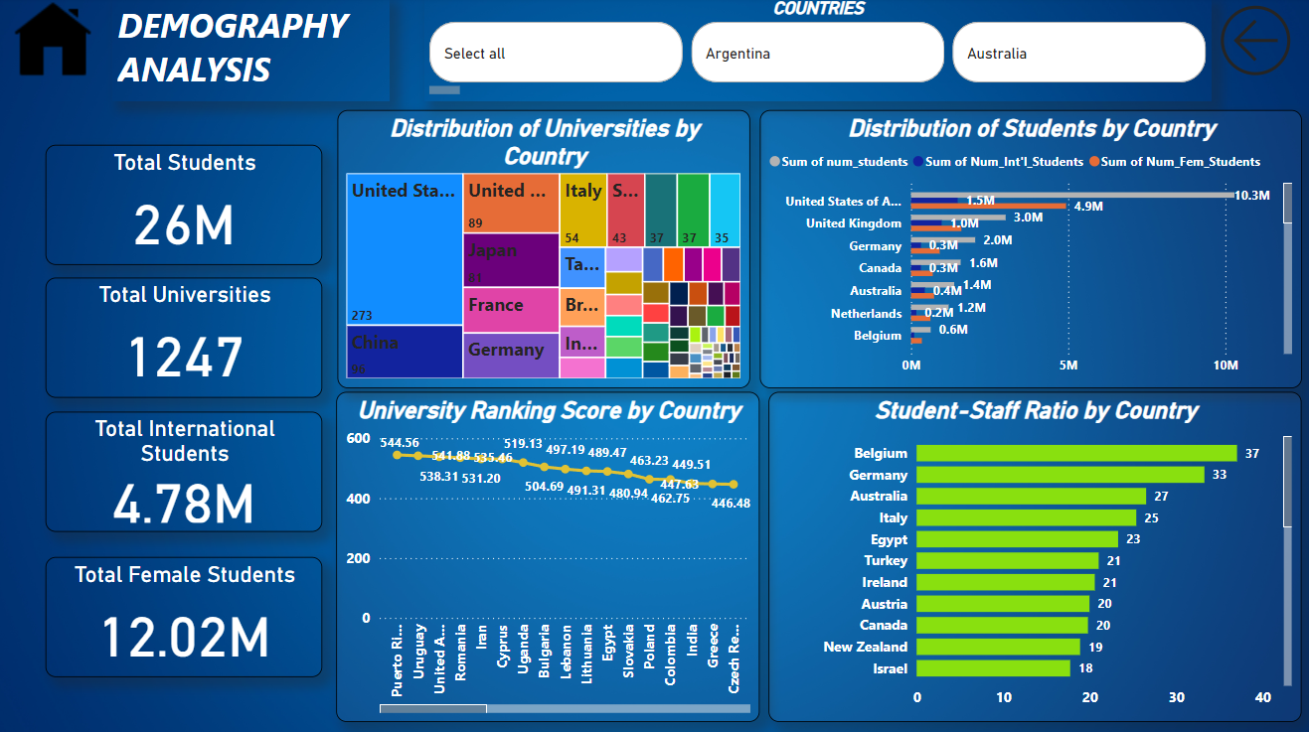
Demography Analysis

Slide 31
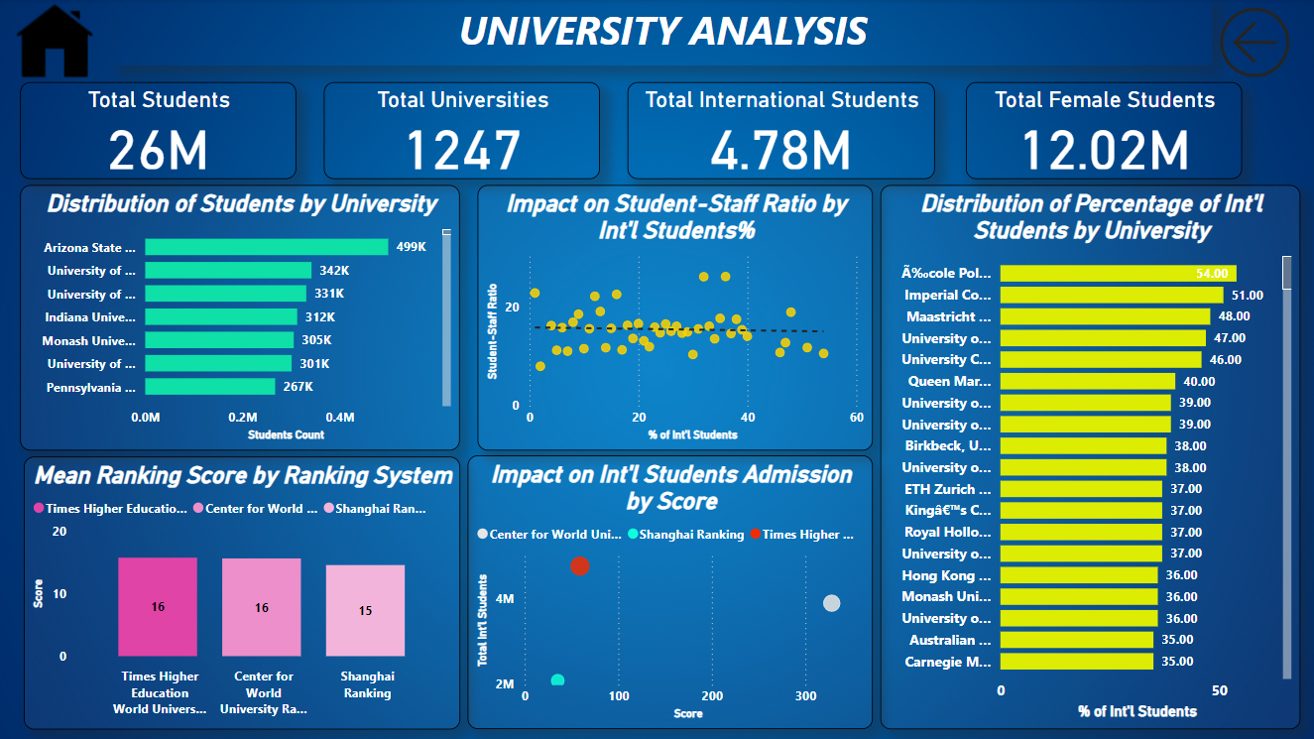
University Analysis

Slide 32
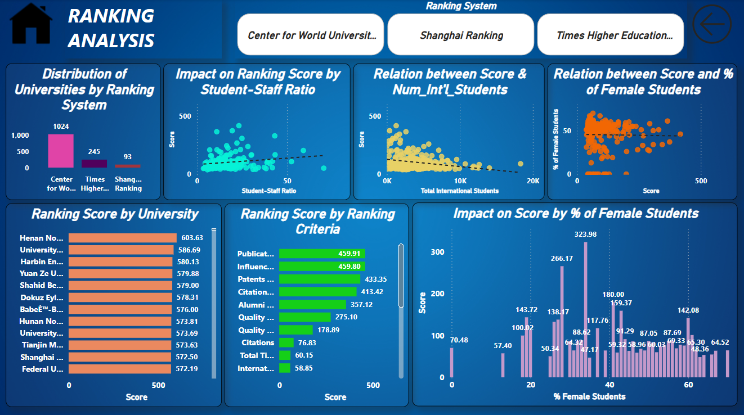
Ranking Analysis

Slide 33
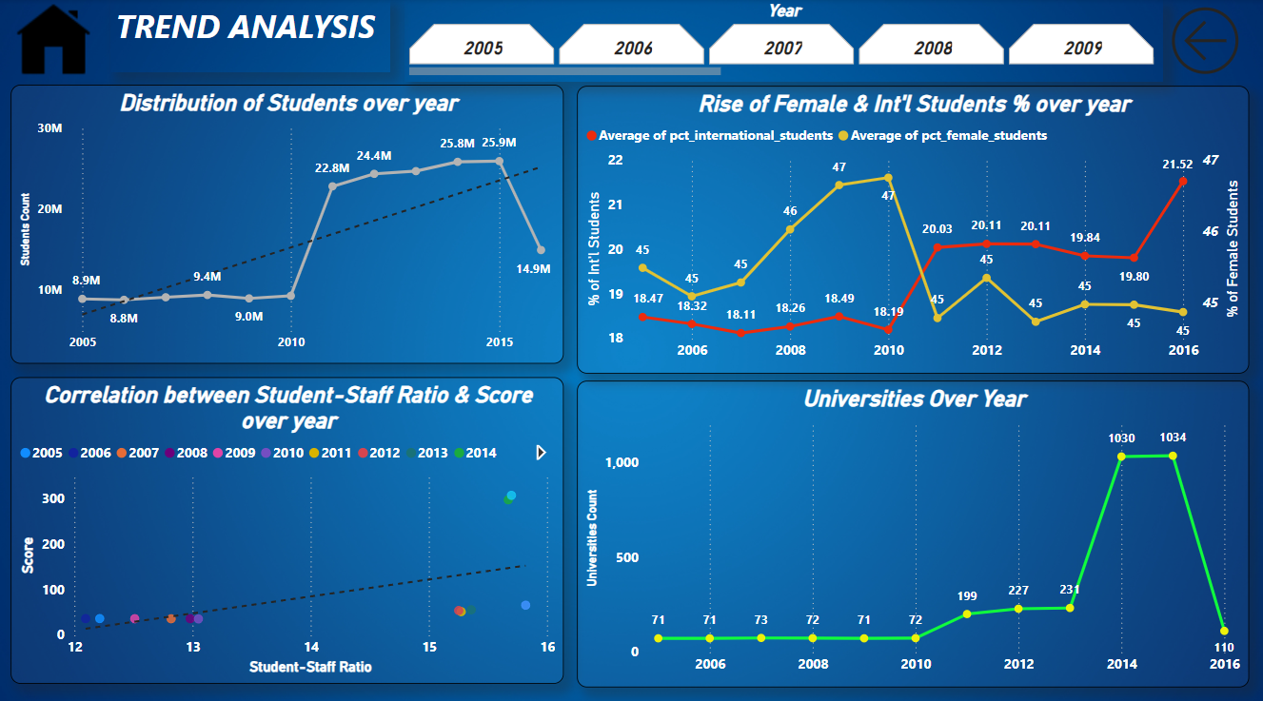
Trend Analysis

Slide 34
Eda Questions
What are the names of universities along with their respective countries in the dataset?
How has the number of universities changed over the years in each country?
Which University Has Better Student-staff Ratio?
Are there any common criteria used by different ranking systems?
What is the trend in university rankings over the years according to each system?
How does the choice of ranking system affect a university's international student enrollment?
Are there any criteria that have different weights in different ranking systems?
How have the weights of ranking criteria changed over time?
Is there a relationship between a university's score and the student-staff ratio?
How does the number of female students differ among universities?
What is the distribution of universities across different countries?
How has the ranking of universities changed over the years?
What is the trend in the percentage of female students over time?
How has the ranking score of universities evolved over the years?
Is there a relationship between a university's ranking score and the number of students over time?

Slide 35
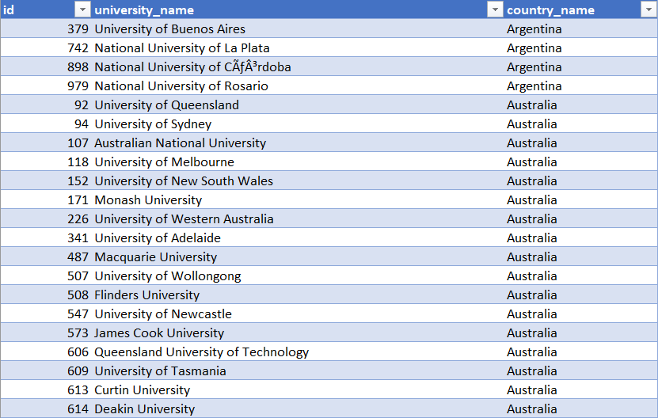

What are the names of universities along with their respective countries in the dataset?
The dataset provides a comprehensive list of universities along with their respective countries, offering insights into the global distribution of higher education institutions. This information can be leveraged to analyse geographical patterns in university rankings, assess international collaborations in research and academia, and understand regional disparities in educational opportunities.

Slide 36
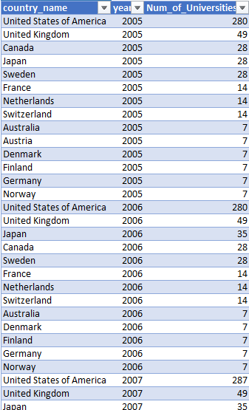
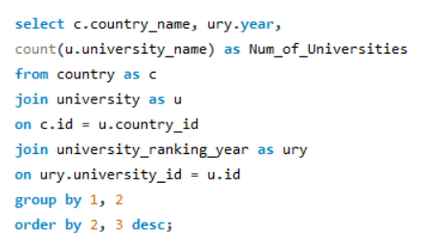
How has the number of universities changed over the years in each country?
This graph illustrates the distribution of universities across various countries. Most nations have relatively few institutions, as shown by the low baseline. However, three countries - Belgium, Greece, and the United Kingdom - stand out with dramatically higher numbers of universities, depicted by tall spikes on the chart. These spikes, reaching up to about 2,500 universities, contrast sharply with the lower counts in other countries. The graph reveals significant disparity in higher education infrastructure among nations, with a few countries having a notably larger university presence. This pattern could reflect differences in population, education policies, or historical developments in tertiary education across these countries.

Slide 38
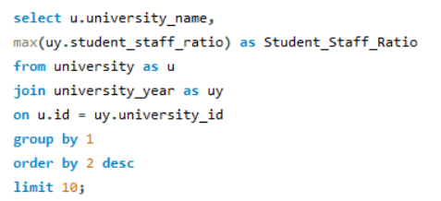
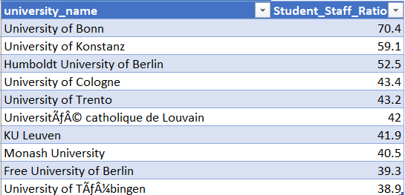
Which University Has Better Student-staff Ratio?
This pie chart illustrates the student-staff ratios for nine different universities. The University of Bonn has the highest ratio at 70.4 students per staff member, significantly higher than the others. The University of Konstanz follows with 59.1, and Humboldt University of Berlin is third with 52.5. The remaining universities have ratios ranging from about 38 to 43 students per staff member, with relatively small differences between them. This visualization highlights substantial variations in how these institutions allocate their human resources, with some universities having nearly twice the number of students per staff member compared to others. Such differences could impact the quality of education, student support, and overall academic experience at each institution.

Slide 40
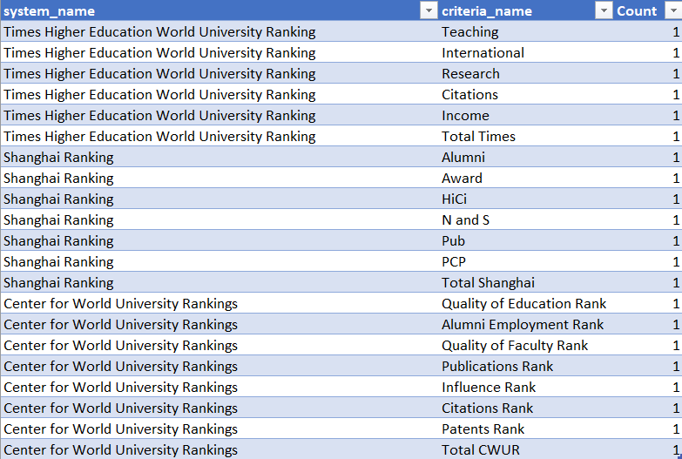
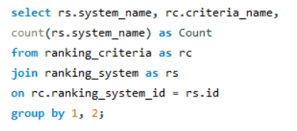
Are there any common criteria used by different ranking systems?
As evident from the chart, each ranking system employs its unique set of criteria, indicating the absence of common criteria across systems. This suggests that every ranking system utilizes its distinct parameters and methodologies to evaluate universities.

Slide 41
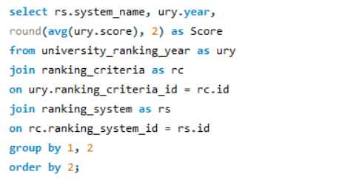
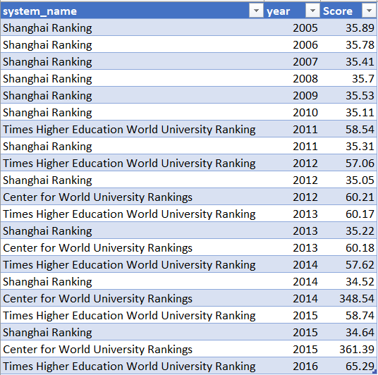
What is the trend in university rankings over the years according to each system?
Times Higher Education World University Ranking: Scores fluctuate slightly over the years but show an increasing trend from 2011 to 2016, with the average score peaking at 65.29 in 2016. Shanghai Ranking: Scores remain relatively stable from 2005 to 2013, with a slight decrease towards 2015. Center for World University Rankings: Scores start moderately in 2012 and 2013, but there's a significant spike in 2014 and 2015, with scores jumping to 348.54 and 361.39, respectively.

Slide 42
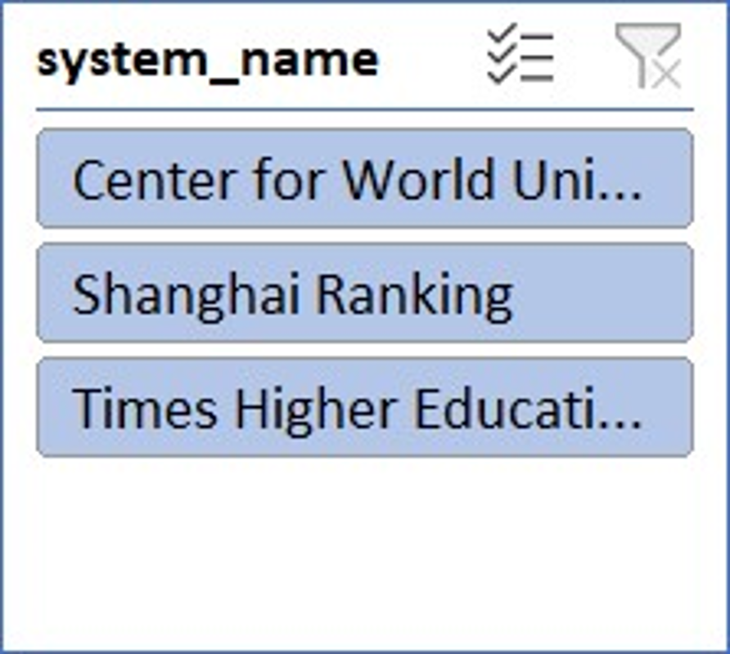

Slide 43
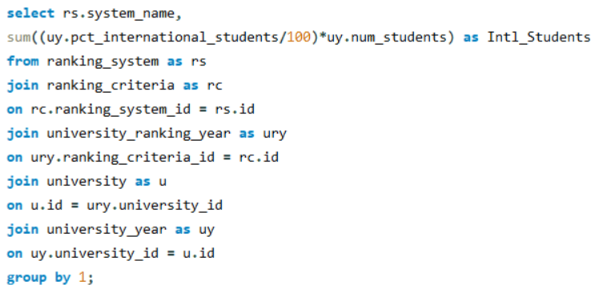
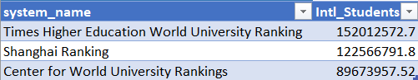
How does the choice of ranking system affect a university's international student enrolment?
This pie chart illustrates the distribution of international students across three major university ranking systems. The Times Higher Education World University Ranking accounts for the largest share at 42%, indicating it's the most popular or influential among international students. Shanghai Ranking follows with 34%, suggesting it's the second most recognized system. The Center for World University Rankings represents 24% of the distribution, the smallest but still significant portion. This visualization highlights the varying degrees of impact these ranking systems have on international student choices or representation, with Times Higher Education having a clear lead in this context.

Slide 45
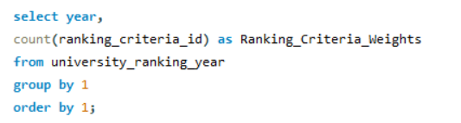
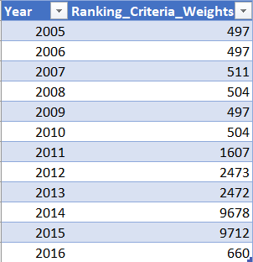
How have the weights of ranking criteria changed over time?
This graph shows the "Ranking Criteria Weights" over time from 2005 to 2016. The most striking feature is the dramatic increase in values starting around 2011. The weights remain relatively low and stable from 2005 to 2010, hovering around 500 or less. However, there's a sharp upward trend beginning in 2011, with the values climbing rapidly each year until reaching a peak of nearly 10,000 in 2014 and 2015. Interestingly, there's a sudden drop in 2016, returning to levels similar to those seen in the early years of the graph. This pattern suggests a significant change in ranking criteria or methodology occurred around 2011, leading to much higher weights for several years before an apparent reversal or adjustment in 2016.

Slide 47
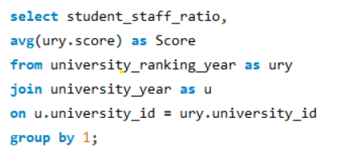
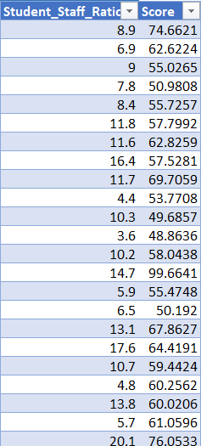
Is there a relationship between a university's score and the student-staff ratio?
This scatter plot displays a relationship between an unnamed variable on the x-axis (ranging from 0 to 80) and a "Score" on the y-axis (ranging from 0 to 450). The data points show a wide dispersion, indicating significant variability in scores. There's a slight positive trend, as indicated by the dotted trendline, suggesting that scores tend to increase moderately as the x-axis variable increases. The majority of data points are clustered in the lower left quadrant of the graph, with x-values between 0 and 30 and scores mostly below 200. However, there are several outliers with notably higher scores, reaching up to around 400. The data becomes sparser as we move right on the x-axis, with fewer points beyond the 40 mark. This pattern could indicate a complex relationship between the variables, where other factors beyond the x-axis measure significantly influence the score. The wide spread of scores, particularly at lower x-values, suggests that while there's a general upward trend, the x-axis variable alone is not a strong predictor of the score.

Slide 49
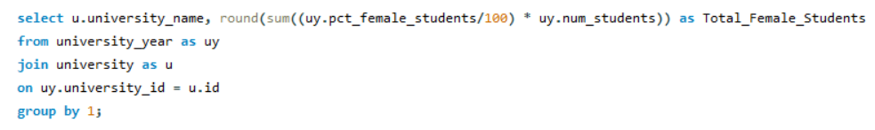
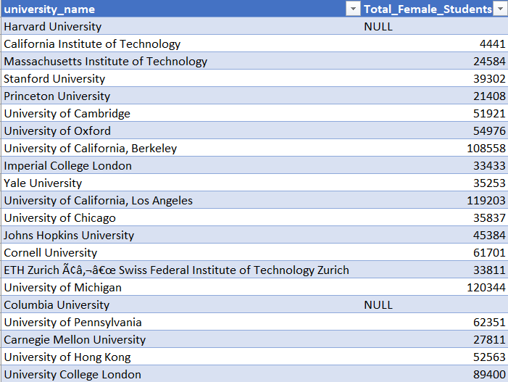
How does the number of female students differ among universities?
The bar chart illustrates the total number of female students across various universities. Notably, there is significant variation in female student populations, with some universities having over 100,000 female students while others have considerably fewer. For example, Harvard University and the University of California, Los Angeles, have relatively high numbers of female students, while many other universities have much smaller populations. This visual highlight the diverse scale of female student enrolment across different institutions, reflecting the varying sizes and possibly the gender demographics of these universities.

Slide 51
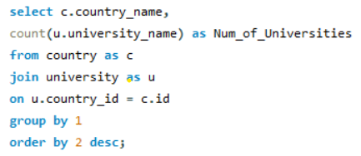
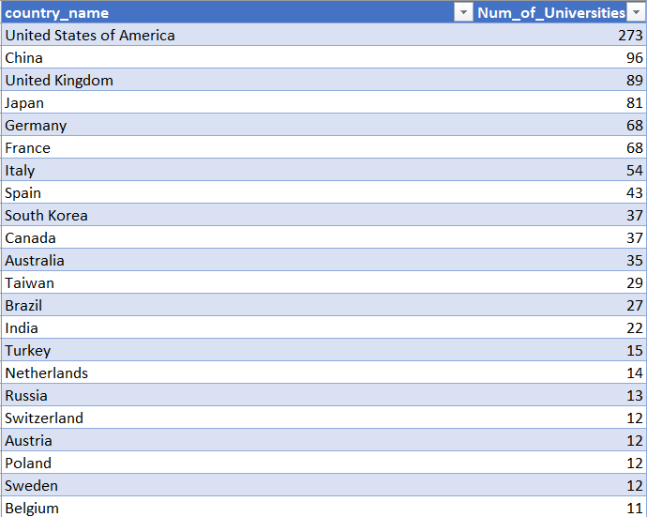
What is the distribution of universities across different countries?
The bar chart illustrates the number of universities across various countries. The United States of America leads significantly, with over 250 universities, followed by the United Kingdom, Germany, and Italy, each with considerably fewer institutions. Other countries such as South Korea, Australia, and Brazil also have a notable number of universities, but the numbers drop off sharply after the top few countries. The chart shows a wide disparity in the distribution of universities, with many countries having fewer than 10 institutions represented, highlighting the concentration of higher education institutions in a few key nations.

Slide 53
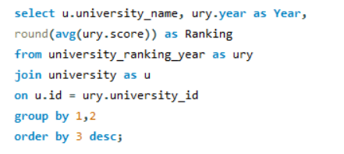
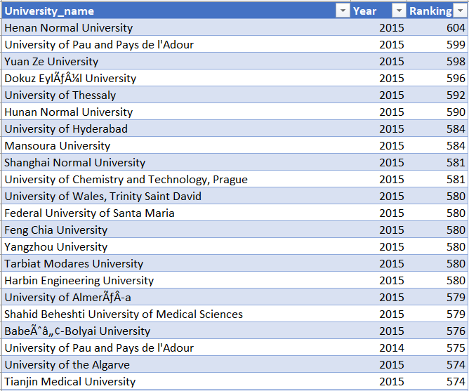
How has the ranking of universities changed over the years?
The bar chart depicts the ranking distribution of various universities, with Michigan State University at the top. The rankings increase gradually as we move down the list, with Henan Normal University appearing at the lower end. This visual indicates a wide range of university rankings, showcasing a gradual decrease from lower to higher-ranked institutions, suggesting a relatively even spread across the rankings rather than sharp drops or clusters.

Slide 54
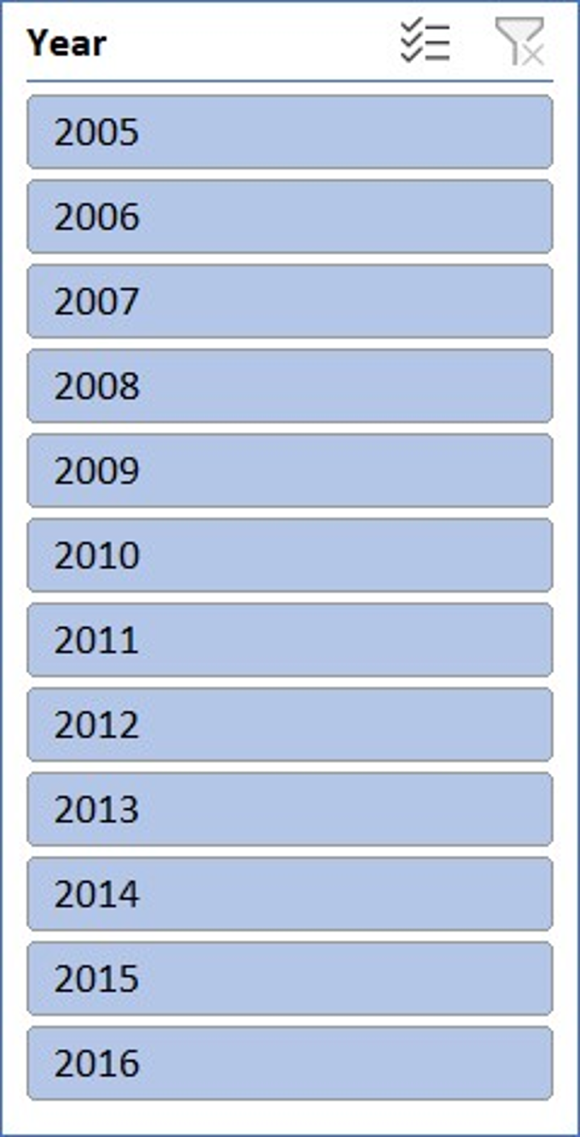

Slide 55
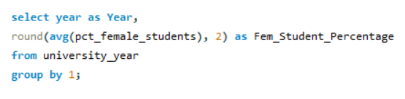
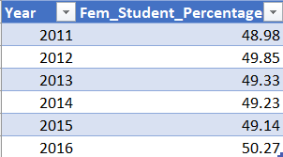
What is the trend in the percentage of female students over time?
The line chart displays the percentage of female students from 2010 to 2016. The percentage starts at approximately 49% in 2010 and peaks at nearly 50% in 2012. Following 2012, there is a gradual decline in the percentage, reaching its lowest point around 2015 at just under 49%. However, there is a sharp increase in 2016, bringing the percentage back up to above 50%. This indicates some fluctuations in female student enrolment over the years, with a notable recovery and improvement by the end of the observed period.

Slide 57


How has the ranking score of universities evolved over the years?
The bar chart displays the ranking scores of various universities. Harvard University and other top institutions show relatively high-ranking scores, while many other universities have lower scores. There are significant variations in ranking scores, indicating a wide disparity in performance or reputation among the institutions listed. The chart also highlights that a few universities have exceptionally high scores compared to the majority, which tend to cluster around lower values.

Slide 59


Is there a relationship between a university's ranking score and the number of students over time?
This combined bar and line chart presents two key pieces of information over the years 2005 to 2016. The bars depict the total number of students, with a noticeable peak around 2015 and a significant drop in 2016. The line indicates a percentage measure that consistently increases over the same period, reaching 100% by 2016. This could represent the cumulative growth or another metric reaching its maximum. The chart suggests a relationship where, despite fluctuations in the total number of students, the percentage metric steadily improves.

Slide 60


Slide 61
Conclusion
This University Success Analysis highlights key factors contributing to university rankings worldwide:
Ranking Systems Variability: CWUR ranks more universities than THE and Shanghai, indicating different criteria and scopes.
Top Universities: Institutions from diverse regions excel, emphasizing the global nature of higher education. Notable performers include Henan Normal University and the University of Pau and Pays de l'Adour.
Student-Staff Ratios: Consistent ranges across systems, with Shanghai showing a lower ratio, suggest a focus on personalized education.
Female Student Representation: Significant female presence in higher education indicates good gender diversity and inclusivity practices.
Geographic Distribution: The dominance of the US and UK is evident, but many other countries also show strong commitment to higher education excellence.
Overall Rankings: A gradual decline in rankings from top to lower-tier institutions reflects a broad spectrum of performance levels.
The analysis underscores the importance of various factors like faculty availability, gender diversity, and maintaining high standards to achieve and sustain success in the global education landscape

